Slide 1

ADAPTERS IN ANDROID
By-
Madhavi Nalluri

Slide 2

What is Adapter?
In Android, Adapter is a bridge between the UI component and the data source which helps to fill data in the UI component.
Here the data set can be anything that presents the data in the structured manner. It might be Arrays, List objects and cursor objects.
It holds the data and send the data to an Adapter view then view can takes the data from the adapter view and shows the data on different views like as ListView, GridView, Spinner etc.

Slide 3
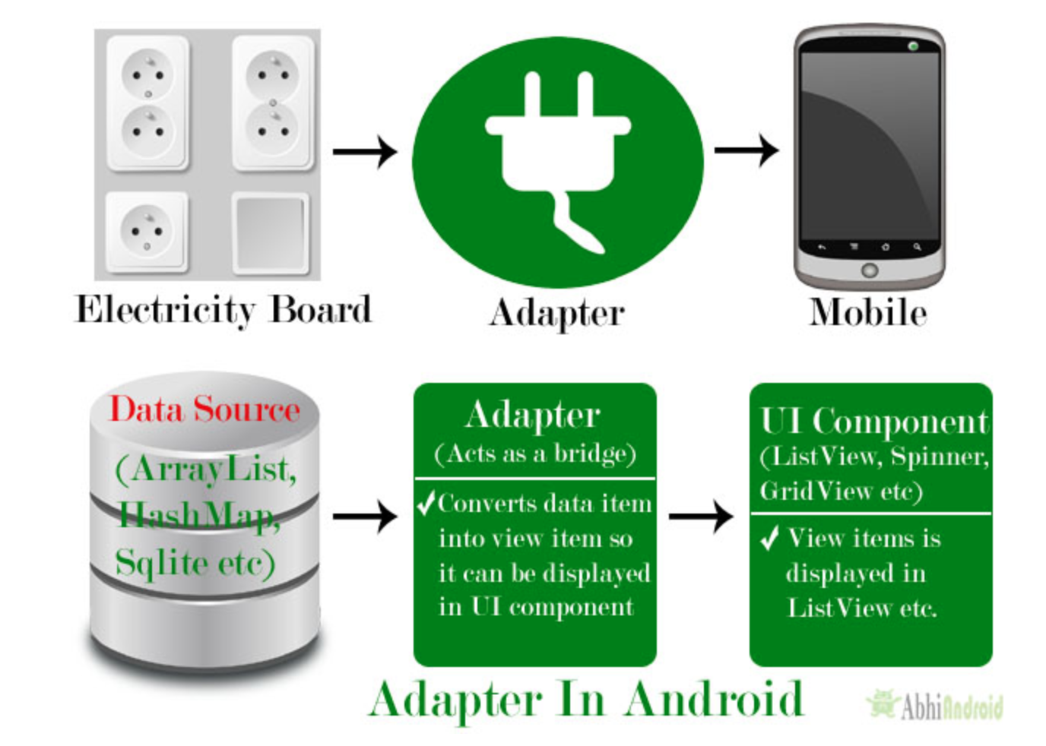
What is adapter?
In this slide, we can see the data source which might be a database or array of the data or some list.
The Adapter takes the data , create a view out of that data and it gives it to someone called the Adapter view. By this we can say the Adapter is only responsible for taking the data and managing the data.
Adapter View displays the data as we want. It is responsible for controlling how data should be displayed.

Slide 4
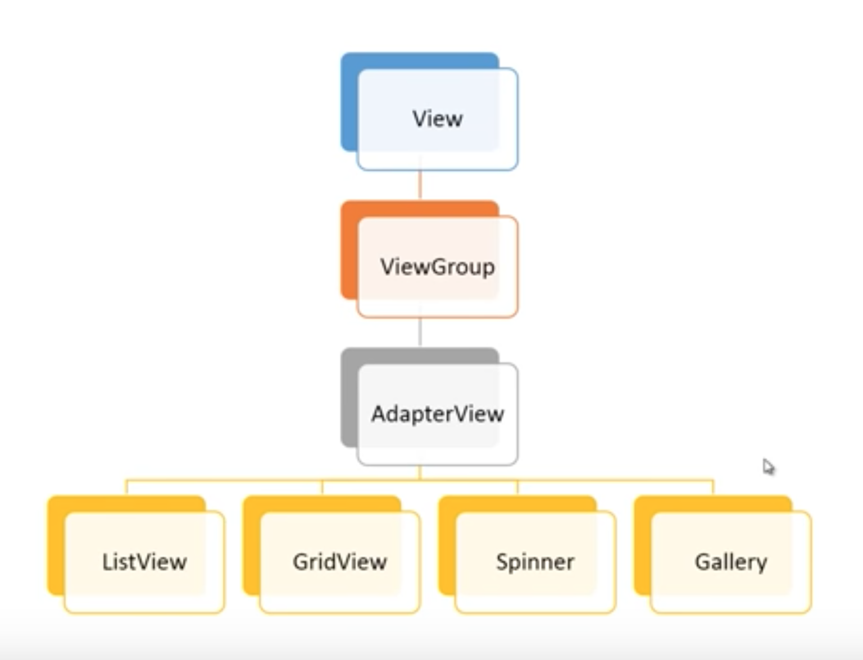
What is Adapter?
We can take data from array, list or database, so we have different kinds of the adapters.
In the same way, we can display the data vertically in list, rows or columns, in the gallery view or drop-down view. So we do have different kind of views.
Some views display new objects repeatedly, if we take a list view it is nothing but list of views inside each view is an object and it has some data in it like the name of a person. The adapter view contains a set of views that display data form a data source using the adapter.

Slide 5

TYPES OF ADAPTER VIEWS

Slide 6
List view
It displays a vertically scrolling list of View objects with which the user can interact.

Slide 7
GRID VIEW
It displays the data in the rows and columns which is like a Grid of view objects with which user can interact.

Slide 8
Spinner
It displays a list of items similar to a drop down menu

Slide 9
Types of Adapters

Slide 10
Different ADapters
There are the some commonly used Adapter in Android used to fill the data in the UI components.
BaseAdapter – It is parent adapter for all other adapters
ArrayAdapter – It is used whenever we have a list of single items which is backed by an array
Custom ArrayAdapter – It is used whenever we need to display a custom list
SimpleAdapter – It is an easy adapter to map static data to views defined in your XML file
Custom SimpleAdapter – It is used whenever we need to display a customized list and needed to access the child items of the list or grid

Slide 11
Interfaces
The Adapter is actually an interface.
All Adapters ultimately implement the Adapter interface. However, the two sub-interfaces of Adapter are List Adapter and Spinner Adapter.
These adapter interfaces define the adapter for List Views and Spinner Views– the two main types of AdapterView.
So, in general, when you are using a List View (to include Grid Views) in your user interface, you are going to need an Adapter that implements (directly or indirectly) the List Adapter. When you are using a Spinner, you are going to need an Adapter that implements (directly or indirectly) the Spinner Adapter.

Slide 12
Base Adapter
The source of much confusion comes from the fact that the Base Adapter is the abstract class that implements the interfaces – all of them! In implements List Adapter, Spinner Adapter and Adapter!
Base Adapter is provided as a convenience to Android developers. Rather than creating a class the implements Adapter, Spinner Adapter or List Adapter, just extend Base Adapter and implement the specialized methods for either a List View or Spinner.

Slide 13
Base Adapter
At a minimum, you will need to implement four methods. These four methods are called by Android to build your AdapterView and to return the correct information when one of the items in the AdapterView is selected.
getCount( ): indicates to Android how many items (or rows) are in the data set that will be presented in the AdapterView.
getItem(int pos): get the data item associated with the item (or row) from the AdapterView passed as a parameter to the method. This method will be used by Android to fetch the appropriate data to build the item/row in the AdapterView.
getItemId(int pos): This method returns the data set’s id for an item/row position of the AdapterView. Typically, the data set id matches the AdapterView rows, so this method just returns the same value.
getView(int position, View convertView, ViewGroup parent): This method creates the View (which may be a single View component like a TextView or a complex set of widgets in a layout) that displays the data for the specified (by position) item/row in the AdapterView.

Slide 14
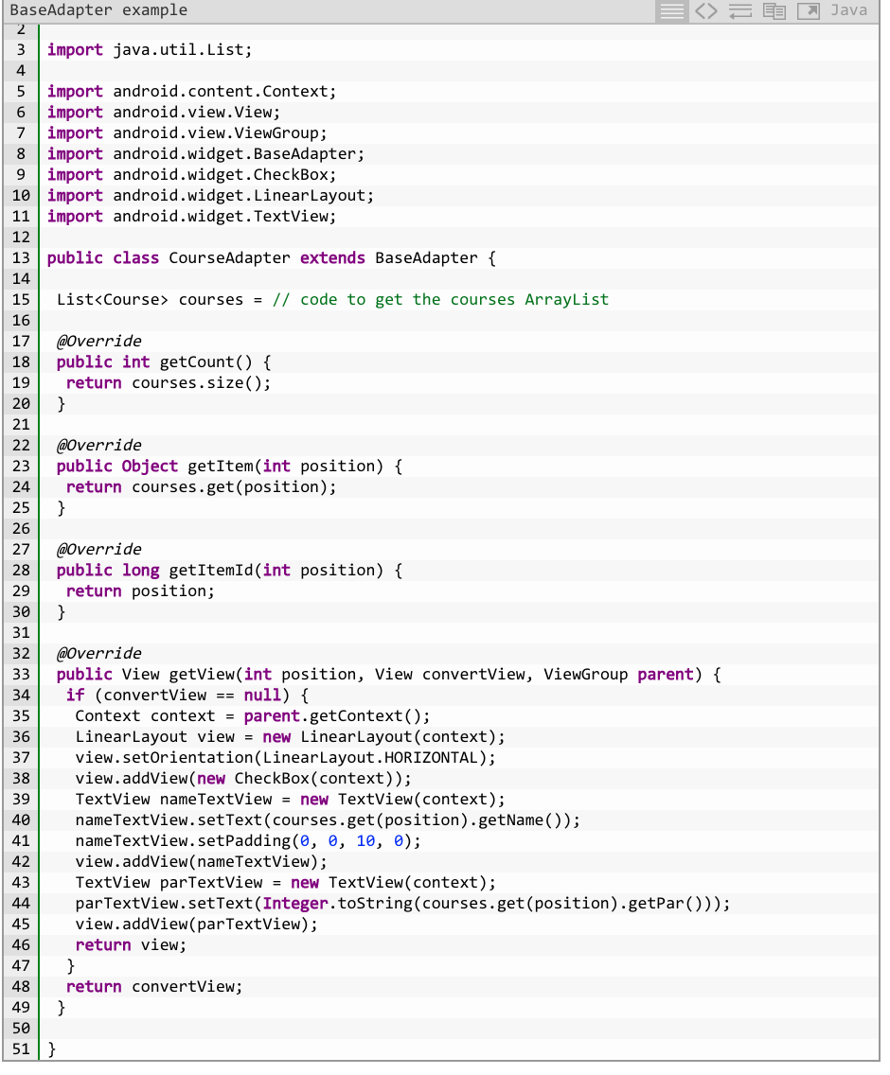
Base Adapter
In the example code above, the getView( ) method programmatically builds the view that represents each course in the ListView display. However, you could use an XML layout file to help construct the View.

Slide 15
Base Adapter can be assigned to list View
Also, note that the adapter (CourseAdapter above) is not directly tied to the type of AdapterView. This adapter could be assigned to a ListView…

Slide 16
Array Adapter
Whenever you have a list of single type of items which is backed by an array, you can use ArrayAdapter. For instance, list of phone contacts, countries or names.
By default, ArrayAdapter expects a Layout with a single TextView, If you want to use more complex views means more customization in grid items or list items, please avoid ArrayAdapter and use custom adapters.
Note: ArrayAdapter is an implementation of BaseAdapter so if we need to create a custom list view or a grid view then we have to create our own custom adapter and extend ArrayAdapter in that custom class. By doing this we can override all the function’s of BaseAdapter in our custom adapter.

Slide 17
Code for Array Adapter
ArrayAdapter(Context context, int resource, int textViewResourceId, T[] objects)
Parameters used in Array Adapter:
Context: The first parameter is used to pass the context means the reference of current class. We can also use getApplicationContext(), getActivity() in the place of this keyword. getApplicationContext() is used in an Activity and getActivity() is used in a Fragment.
Resource: The second parameter is resource id used to set the layout(xml file) for list items in which you have a text view.
textViewResourceId: The third parameter is textViewResourceId which is used to set the id of TextView where you want to display the actual text.
Objects: The fourth parameter is an array of objects, used to set the array of elements in the textView. We can set the object of array or array list here.

Slide 18
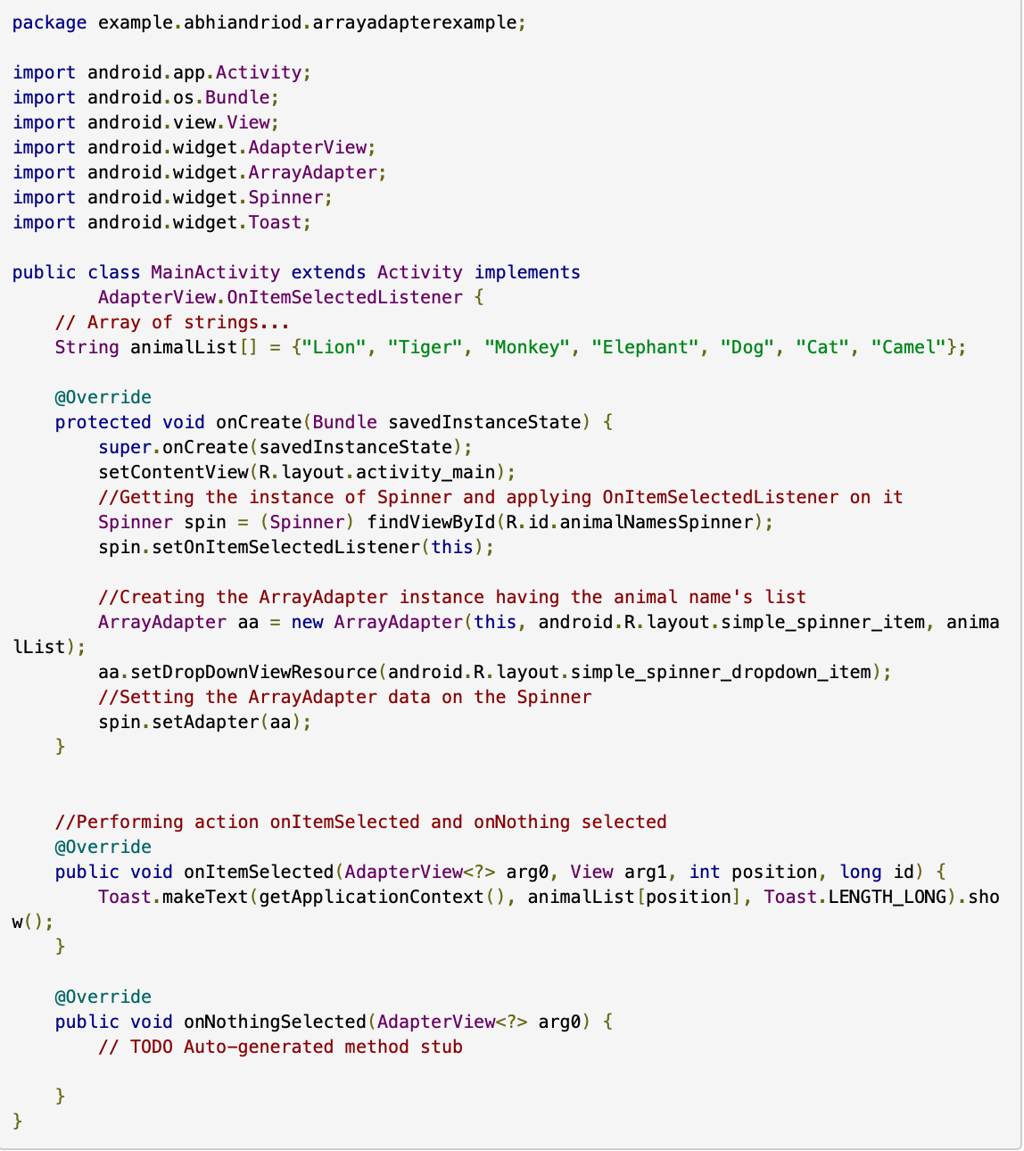
Example of an Array Adapter

Slide 19
Simple Adapter
SimpleAdatper’s data set is an ArrayList of Maps. Each Map in the ArrayList contains the data to be displayed for a row in the AdapterView. Unlike the other adapters, the data set is expected to be static – that is, it is not changing.
Each entry in an ArrayList is corresponding to one row of a list. The Map contains the data for each row. You also specify an XML file(custom list items file) that defines the views used to display the row, and a mapping from keys in the Map to specific views.
Whenever we have to create a custom list we need to implement custom adapter. As we discuss earlier ArrayAdapter is used when we have a list of single item’s backed by an Array. So if we need more customization in a ListView or a GridView we need to implement simple adapter.

Slide 20
Simple Adapter
SimpleAdapter(Context context, List<? extends Map<String, ?>> data, int resource, String[] from, int[] to)
context: The first parameter is used to pass the context means the reference of current class. Here this is a keyword used to show the current class reference. We can also use getApplicationContext(), getActivity() in the place of this keyword. getApplicationContext() is used in a Activity and getActivity() is used in a Fragment.
data: The second parameter is data which is a List of Maps. Each entry in a List corresponds to one row in the list. The Maps contains the data of each row and should include all the entries specified in “from” string array.
resource: The third parameter is resource id which is use to set the layout (xml file) for list items in which you have a text view, image view or any other view.
from: The fourth parameter is from is an string array or called a list of column names that will be added to a Map associated with each item of a grid or list view.
to: The fifth and last parameter is to which is an integer array used to store the Id’s of the views. The views that should display column in the “from” parameter. These should all be TextViews. The first N views in this list are given the values of the first N columns in the “from” parameter.
SimpleAdapter (this, hashmapData, R.layout.custom_list_items, fromArray,to)

Slide 21

Thank you

